Slide 1

Boston Expenses Report
Presented by
LOHIT AKSHANT NIMMA

Slide 2

DataSets Used
Checkbook Explorer - Dataset - Analyze Boston (2018-2023)
Employee Earnings Report - Dataset - Analyze Boston (2018-2023)

Slide 3
Business Questions
Which department has the most employees, and how does this compare to other departments?
Which department has the highest earnings report?
Was there a particular year that saw a significant increase or decrease in expenses?
Which departments spent the most over the last five years?
Who are the top vendors by monetary amount spent, and in what years did they receive the most business?

Slide 4
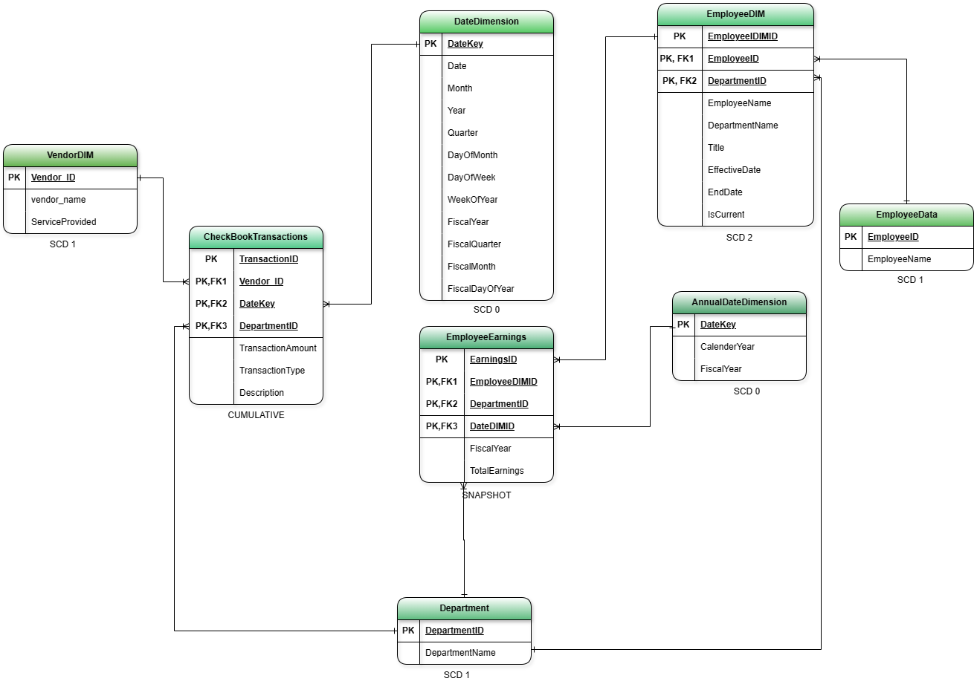
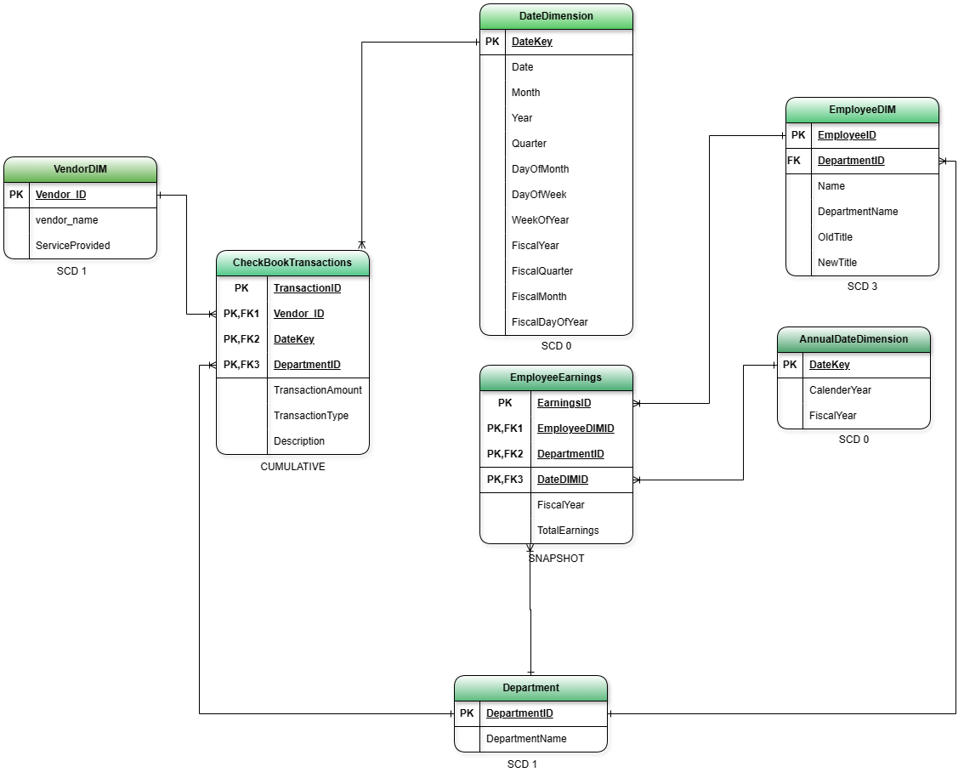
SCHEMA DIAGRAM

Slide 5
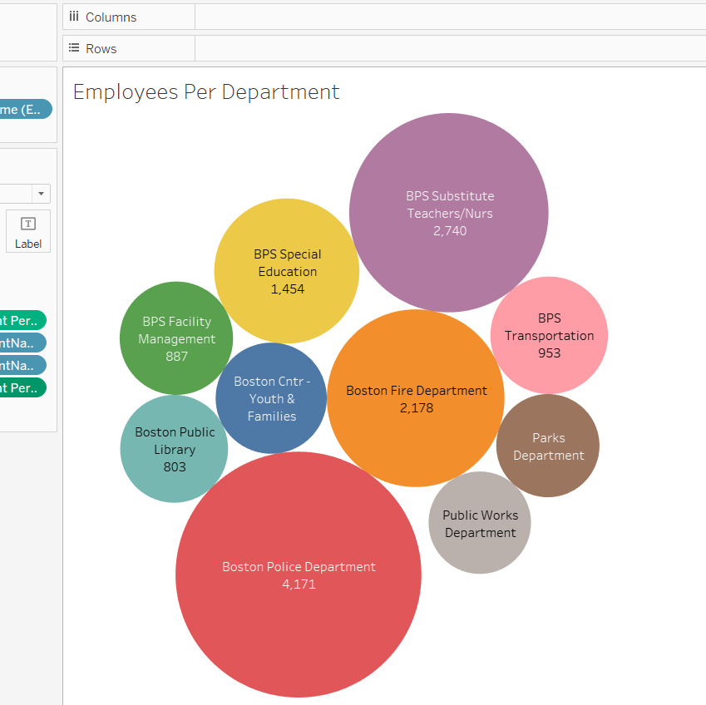
Employees per Department
Boston Police Department has the highest number of employees.
The manpower in the police department states the security efficiency.

Slide 6
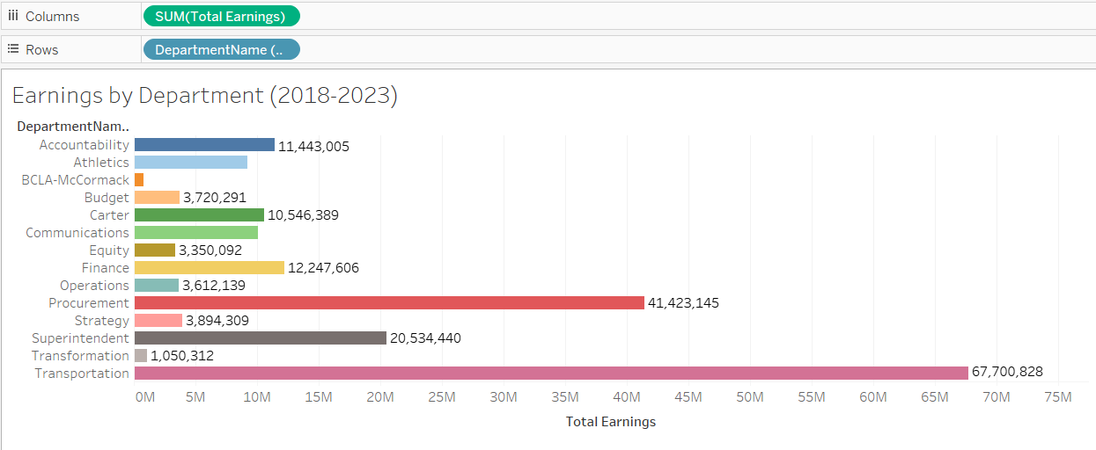
Top Earners by Department

Slide 7

The Transportation is the highest income generated Department overall.
It is followed by Procurement.

Slide 8
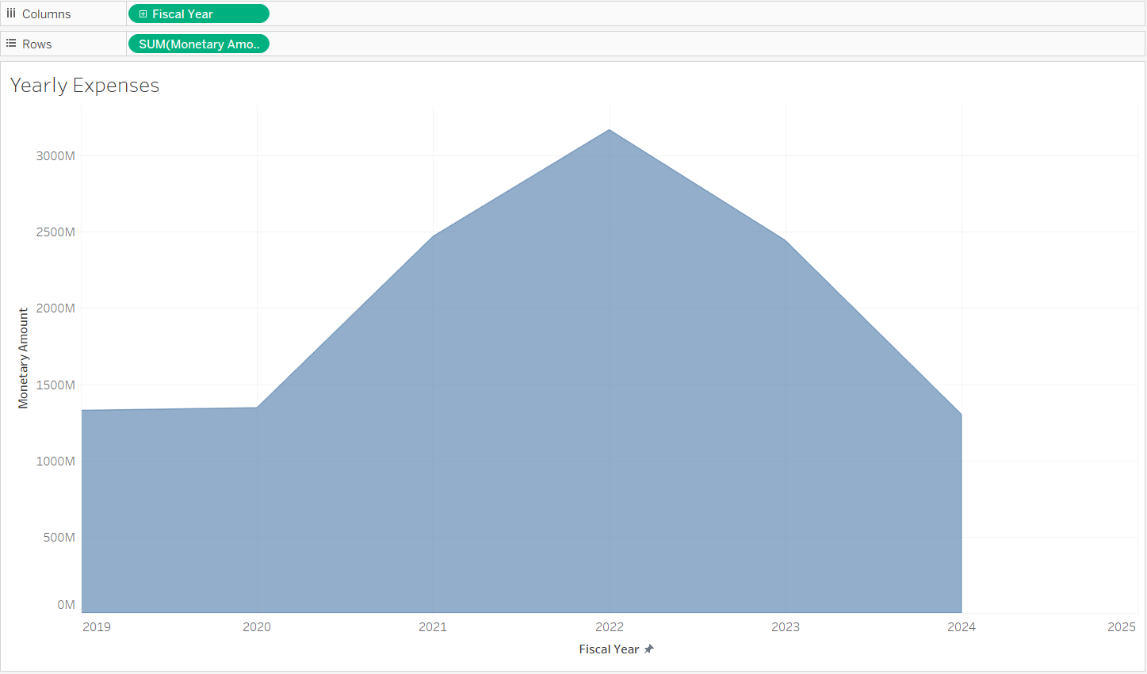
Yearly Expenses
From the Year 2020, there was a significant rise in expenses during the COVID-19 era.
It gradually peaked in 2022 after which it had a significant downfall till the Fiscal Year 2024.

Slide 9
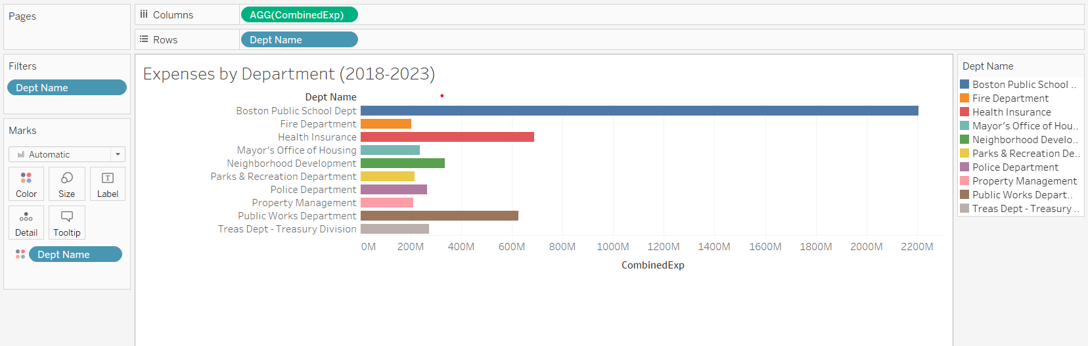
Expenses by Department (2018-2023)

Slide 10

The Boston Public School Department was the top spender in the last 6 years followed by Health Insurance.

Slide 11
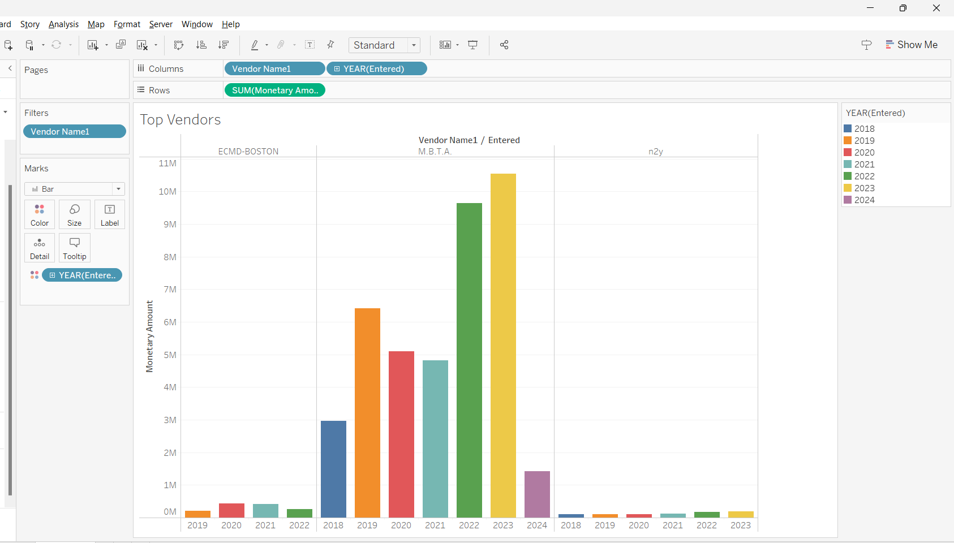
Top Vendors by Business

Slide 12

If we see the vendor data, every year The MBTA has received a lot of business compared to other vendors.
The top 3 vendors every year are held by consistent vendors like- ECMD Boston, MBTA, and n2y.

Slide 13
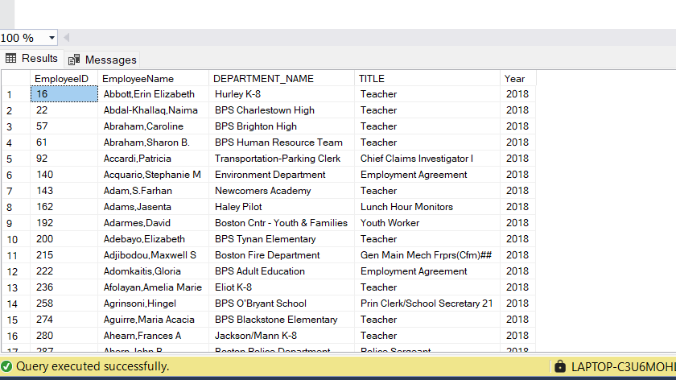
Creating SCD 2:

Slide 14
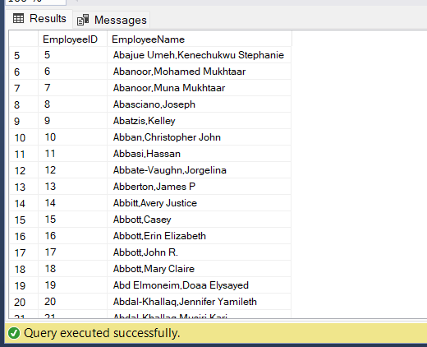
With the emp_rec_18 to emp_rec_23 tables, I have filtered the employee’s names and made a dimension table called EmployeeData.

Slide 15

Procedure:
After that I created an EmployeeDIM table in which I added the attributes- EffectiveDate, EndDate, IsCurrent.
I have joined all the employee records from 2018 to 2023 concerning the “Year” attribute.

Slide 16
SCD 2- EmployeeDIM Table
CREATE TABLE EmployeeDIM (
EmployeeTitleHistoryID INT IDENTITY(1,1) PRIMARY KEY,
EmployeeID INT,
EmployeeName NVARCHAR(255),
EmployeeDept NVARCHAR(255),
Title NVARCHAR(255),
EffectiveDate DATE,
EndDate DATE,
IsCurrent BIT
);

Slide 17
DECLARE @CurrentYear INT = 2018;
DECLARE @MaxYear INT = 2023;
DECLARE @SQL NVARCHAR(MAX);
WHILE @CurrentYear <= @MaxYear
BEGIN
-- Correctly format the table name according to your naming convention
DECLARE @TableName NVARCHAR(50);
SET @TableName = 'emp_rec_' + RIGHT(@CurrentYear, 2); -- Extracts the last two digits of the year
-- Dynamic SQL to handle SCD Type 2 updates
SET @SQL = 'INSERT INTO EmployeeDIM (EmployeeID, EmployeeName, EmployeeDept, Title, EffectiveDate, IsCurrent)
SELECT e.EmployeeID, e.EmployeeName, e.DEPARTMENT_NAME, e.Title, ''' + CAST(@CurrentYear AS VARCHAR) + '-01-01'', 1
FROM ' + @TableName + ' e
LEFT JOIN EmployeeTitleHistory h ON e.EmployeeID = h.EmployeeID AND h.IsCurrent = 1
WHERE h.Title IS NULL OR h.Title <> e.Title;
UPDATE EmployeeDIM
SET EndDate = DATEADD(day, -1, ''' + CAST(@CurrentYear AS VARCHAR) + '-01-01''), IsCurrent = 0
WHERE EmployeeID IN (SELECT EmployeeID FROM ' + @TableName + ') AND IsCurrent = 1 AND Title <> (SELECT TOP 1 Title FROM ' + @TableName + '
WHERE EmployeeID = EmployeeDIM.EmployeeID ORDER BY EmployeeName DESC);';
-- Execute the dynamic SQL
EXEC sp_executesql @SQL;
-- Move to the next year
SET @CurrentYear = @CurrentYear + 1;
END

Slide 18
UPDATE EmployeeDIM
SET EndDate = '9999-12-31'
WHERE EndDate IS NULL;

Slide 19
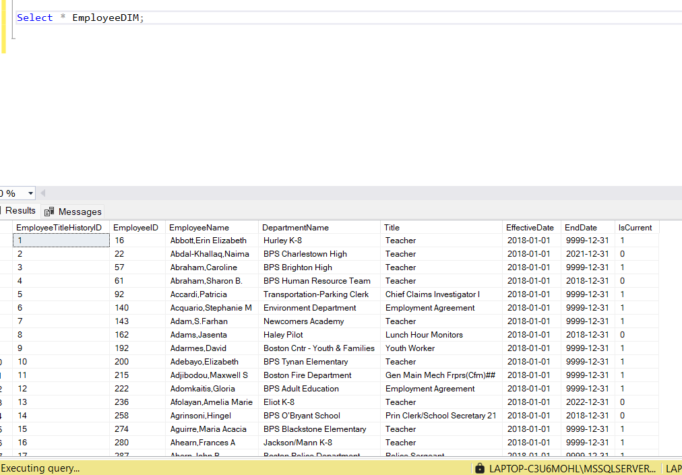
EmployeeDIM:

Slide 20
The presence of columns like EffectiveDate, EndDate, and IsCurrent indicates that this table is set up to handle Slowly Changing Dimensions of Type 2 (SCD 2).
EffectiveDate marks the date when a given record becomes relevant or valid.
EndDate indicates when the record is no longer valid, with a far future date (such as 9999-12-31) often representing that the record is currently valid.
IsCurrent is a Boolean flag (0 or 1) that easily identifies whether the record is the current record for that employee.
This structure allows for full historical tracking: when an attribute of an employee changes, such as their department or title, a new record is inserted with the current date as the EffectiveDate, the IsCurrent flag is set to 1 for this new record, and the previous record is updated to set EndDate to the day before the EffectiveDate of the new record and IsCurrent to 0. This way, the table maintains a complete history of changes over time for each employee.

Slide 21

Conclusion
In this Project we determined the fact tables and dimension tables to bring out insights from the two datasets.
This project mainly focuses on ETL and the Visualization part of Data Engineering.
With different visualizations, this project has further scope to elevate the dashboard and make the end users more informed about the data.

Slide 22

Thank You

